Slide 1
Simple Shooter
Part 6
by TommyX

Slide 2
TextField API
Flash provides a very convenient and powerful system to display and input text, called TextField. They are essentially text boxes with various functionalities. Each TextField is similar to a display object, which can be added to the display list just like movie clip etc.
Lets start by creating a MovieClip as container for our text boxes. We will name it UI which stands for User Interface.
For how to create a new symbol, see past tutorials.

Slide 3



TextField API
Right now we are editing the container (shown here)
To create a new TextField, select the Text Tool on the right.
Then, on the stage, click and drag to draw the text box. It should look like this:

Slide 4
TextField API
There are 3 types of Text Fields:
Static Text: These texts are drawn like images and can’t be edited.
Dynamic Text: These texts can be modified by code to display whatever text you want.
Input Text: These texts can be edited by users clicking on them and typing whatever text they want, and the content of the box at any moment can be accessed or modified by code.

Slide 5
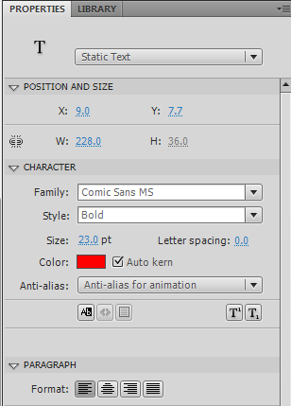
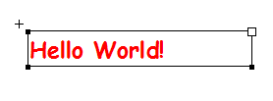
TextField API
With the text box selected, on the properties panel, there are a lot of options you can edit, including text field type(static, dynamic or input), font, color, font size, formatting and more.
We will first make an example static text. First, make sure the text field type is set to static text, then type in whatever you want in the box. Once you are done, switch to the selection tool and click somewhere else on the stage to finish editing.

Slide 6
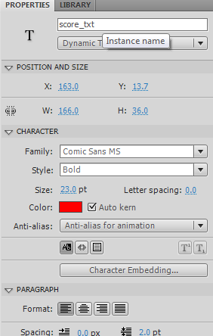

TextField API
Next we will create a dynamic text as example to display scores which we will set up later. Select the text tool and make another text box. Change its type to Dynamic Text, and type in something as placeholder, for example, “---”. If you type nothing, then the text field might be hard to select later.
Once you finished editing, give it an instance name in order to access it later with code.
To access the text of a dynamic or input text box (for example, named “myTextBox”), simply use “myTextBox.text”

Slide 7
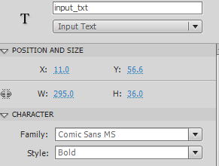
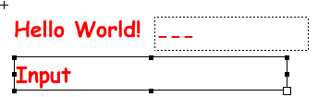
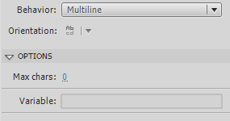
TextField API
Next we will create an input text as example to... Well, for fun.
Select the text tool and make another text box. Change its type to Input Text, and type in something as placeholder, for example, “Input”.
Once you finished editing, give it an instance name in order to access it later with code.
At the bottom of the properties panel for input text, you can set the maximum number of characters the user can enter. 0 means unlimited.
To access the text of a dynamic or input text box (for example, named “myTextBox”), simply use “myTextBox.text”

Slide 8
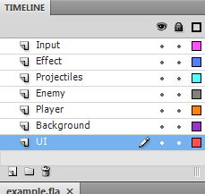

Setting up UI
Once the container and its contents are finished, go back to the stage(important) make another layer called UI and drag the symbol onto the stage in that layer. Make sure the layer is at the bottom of the list, because its script will then be executed last. The exact reason will be explained later.

Slide 9
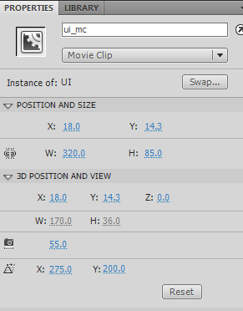
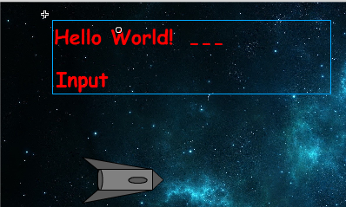
Setting up UI
Give the container an instance name by selecting it and edit the name in the properties panel. Here we use “ui_mc”.

Slide 10
Setting up UI
Click on the frame of this layer and edit the code. Add ui_mc to the root display list by typing in “addChild(ui_mc)”.
When you add something to the display list of some container, the thing being added is always placed on the top. Since we want the UI to be on the top, we should add it last to the display list after adding all the other containers, which is why we place the layer at the bottom.
addChild(ui_mc)

Slide 11
Simple Score System
Lets make a simple score system by creating a variable called score, and then add 10 to it every time an enemy is destroyed.
Go to the Enemy layer and add “var score:Number = 0” on the top. Then, in the enemy’s loop code, find the part where it gets destroyed, and add “score += 10” to it.
var score:Number = 0
…
if (enemy.health <= 0){
score += 10
enemyList.splice(enemyList.indexOf(enemy), 1)
enemy.parent.removeChild(enemy)
enemy.removeEventListener(Event.ENTER_FRAME, loop)
spawnEnemy(700, Math.random() * 400)
}
…

Slide 12
Displaying Health and Score
To display the score, we need to use the dynamic text box. Lets go to the Player layer, and in the loop code, set the text of the text box.
Because we placed the text box inside the UI container, we can access it like a property using the “dot” operator. Using the “+” operator we can combine multiple strings of text and/or numbers to create a combined string of text.
If the text doesn’t display correctly, you might need a bigger text box.
…
function enterFrameHandler(event){
ui_mc.score_txt.text = "Health:" + player_mc.health + " " + "Score:" + score
if (keyUpDown){
…

